Slide 1



Analytics
Do the right thing
Google Merchandise Store
Data Mining Principles
| Carrie Lu | Daniela Matinho |
| Hanna Kerr | Yuling GU |

Slide 2
01
Industry Overview & Business Problem
Do the right thing
02
Data Preparation
03
Data Exploration & Feature Engineering
AGENDA
04
Modeling
05
Results
06
Lessons learned & Future Work
07
Sources
Notes:
Introduction – industry business case – Daniela
Data preparation – notebook – pickleys + Jason + explain the data (features, large → what did we do) - Carrie
Exploratation analyses & Feature eng (1.2% population) - Yuling
- Tsne
- Pca
- Graphs - Hanna
Modeling:
User level - User aggregated – Daniela
Transaction - Hanna
Customer segmentation = LTV – Carrie
Results – Hanna
2 good models and features - Hanna
Future work - Daniela
- Info about the products
- Other years
Conclusion

Slide 3

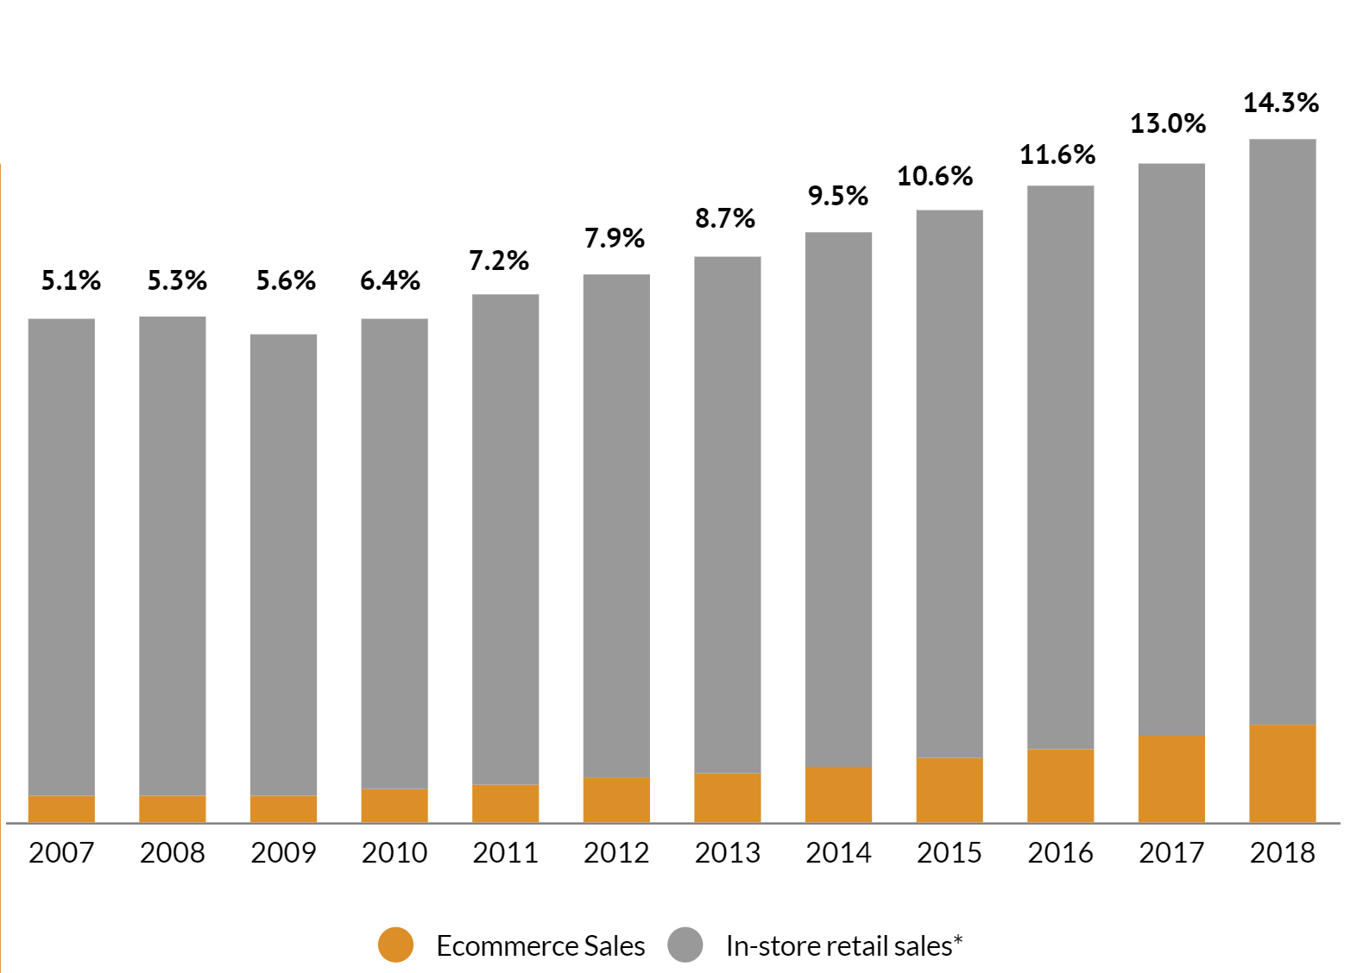
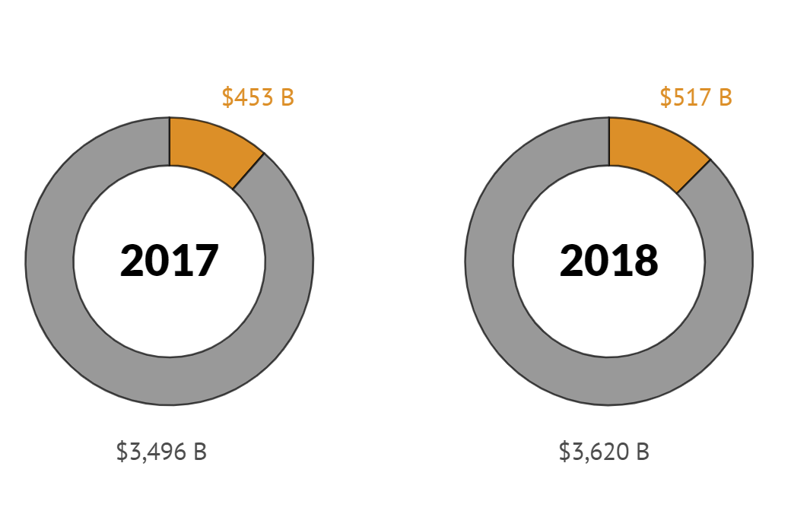
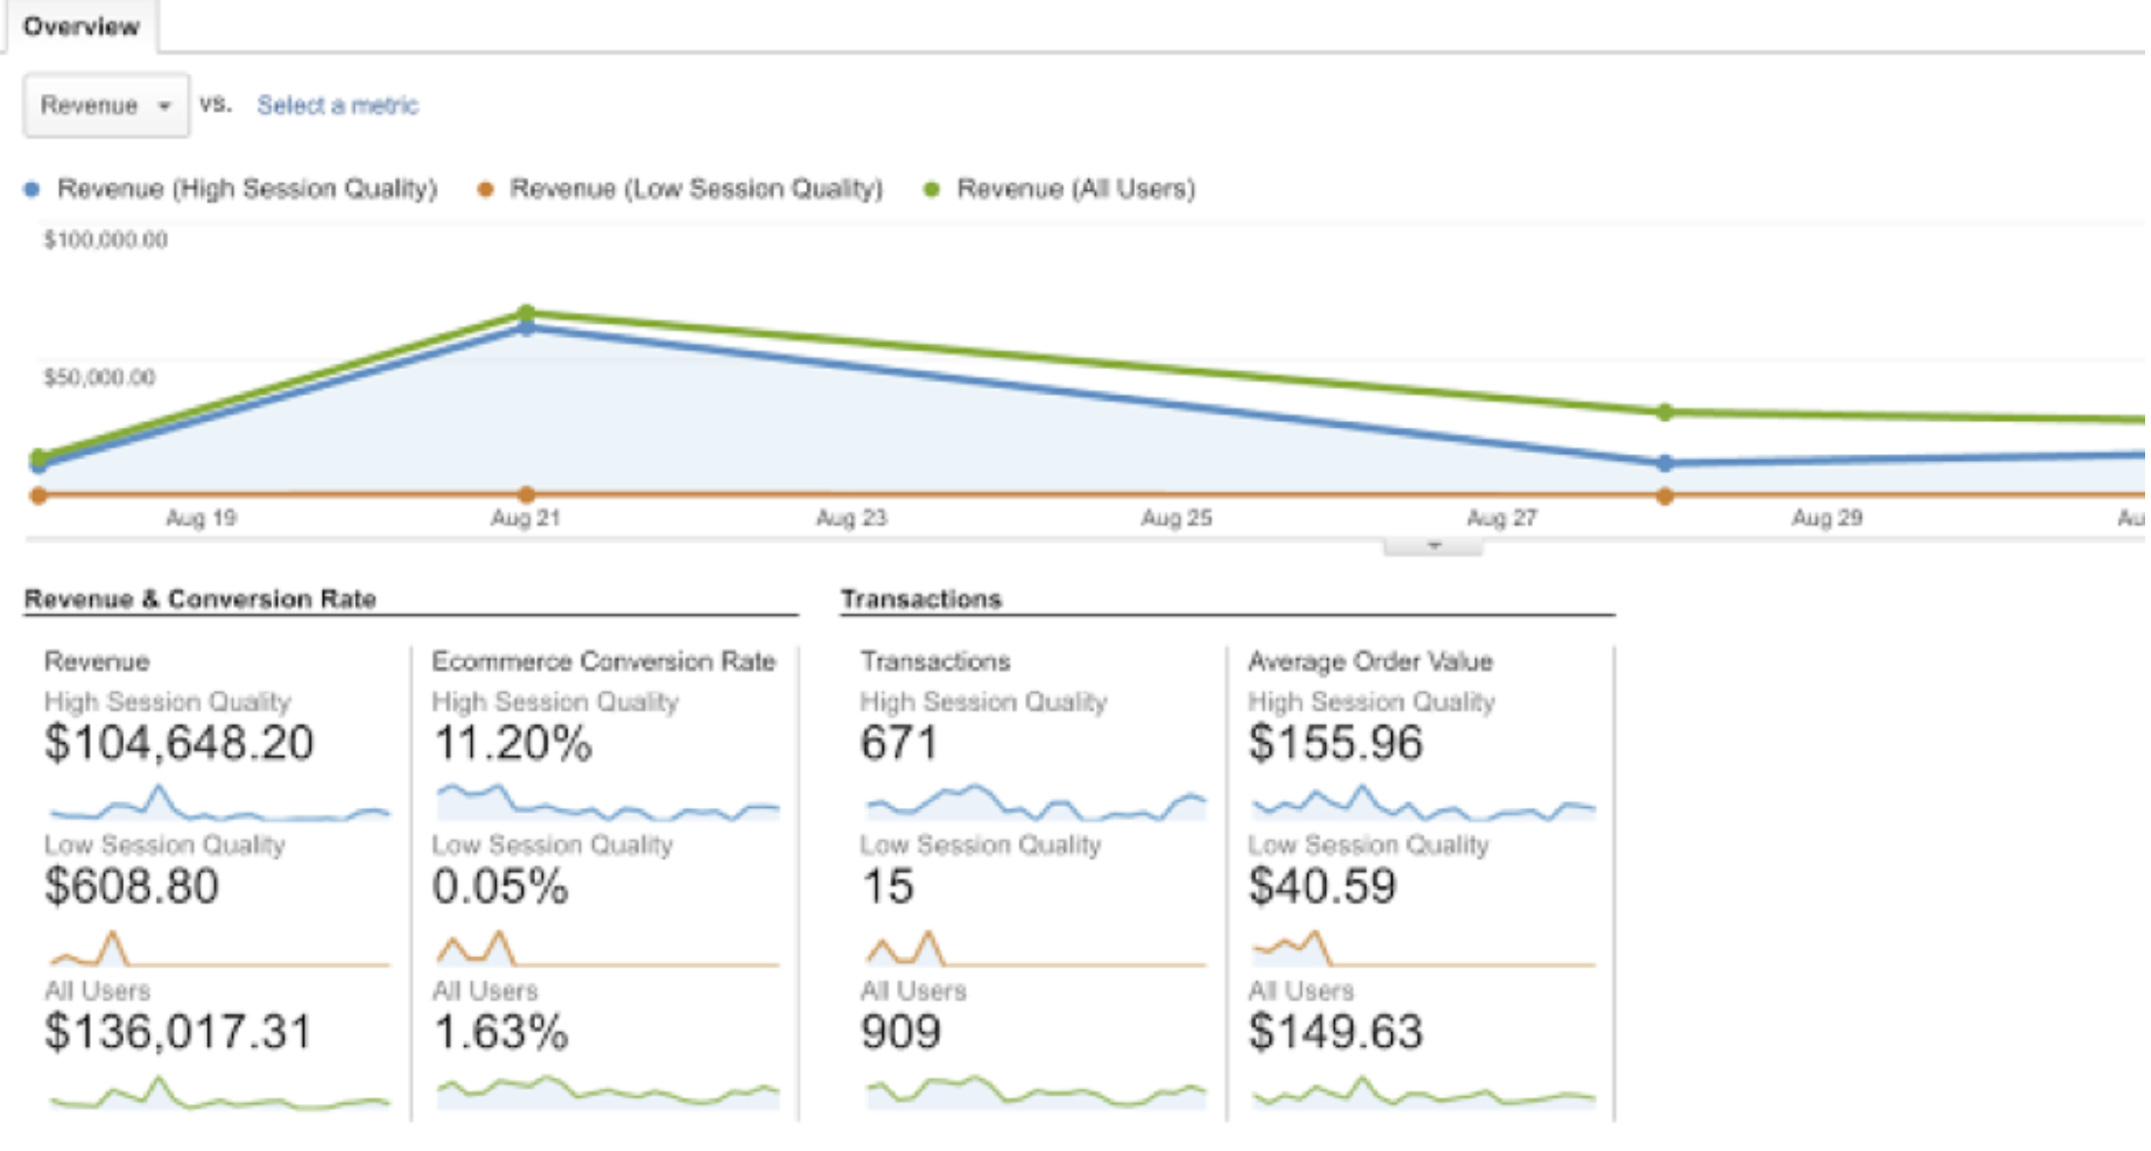
Industry Overview
2020
Over 2 billion digital buyers
2017 – 2021
Retail e-commerce sales account for $2.3 trillion in 2017 and it is projected to grow to $4.88 trillion by 2021
Sales in retail vs E-commerce
Penetration rate retail vs ecommerce
Google Analytics is a web analytics service that allows you to analyze in-depth detail about the visitors on your website.
Notes:
They can capture a lot of data

Slide 4


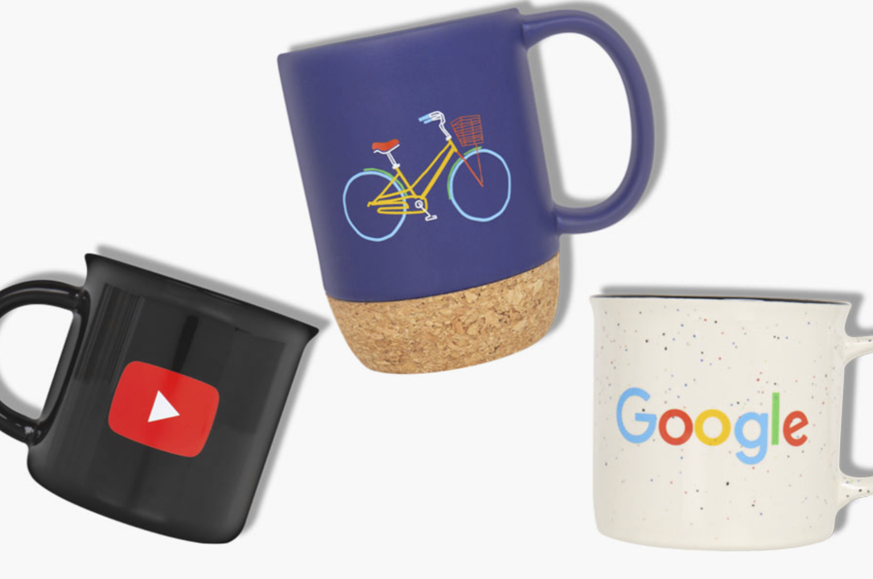
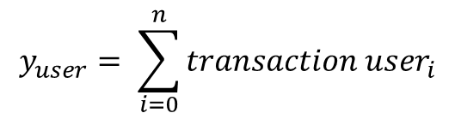
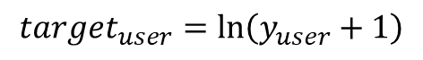
Google Store
The 80/20 rule has proven true for many businesses, only a small percentage of customers produce most of the revenue.
Understanding how much each customer spends will allow companies to place actionable operations
to better allocate their
marketing budgets.
Do the right thing
Problem Statement
Predict the natural log of the sum of all transactions per user
$$y_{user}= \sum_{i=0}^{n}{transaction{ user}_{i}}$$
$${target}_{user}=\ln\left(y_{user}+1\right)$$

Slide 5

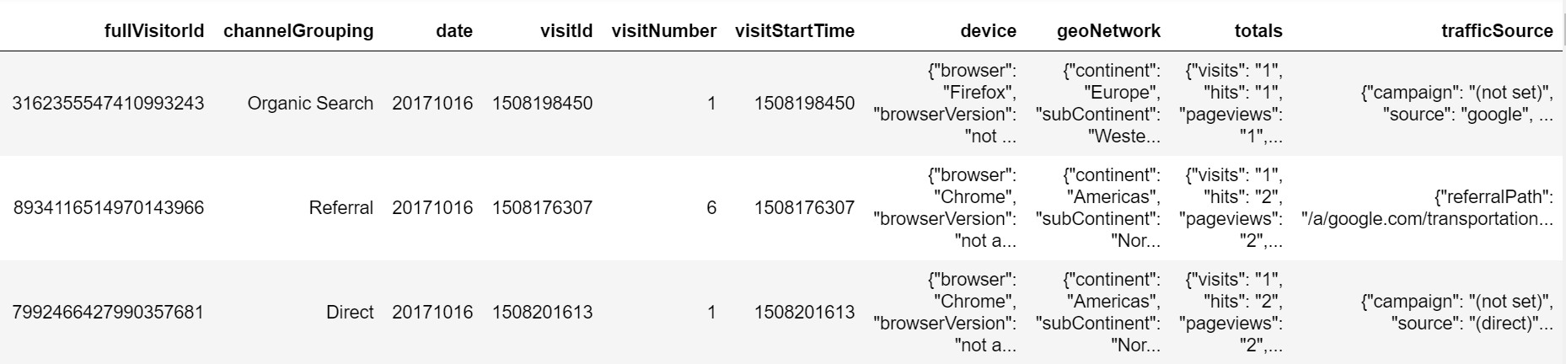
Data Preparation
Dataset Columns
fullVisitorId
channelGrouping
date
visitId
visitNumber
visitStartTime
Jason Columns
device
geoNetwork
totals
trafficSource
Nr of rows: 928,860
Nr of unique users: 716,705
Parse JSON
2017
Data Frame
Chunk
Read Chunks
JSON Columns
24 GB
Select 2017

Slide 6
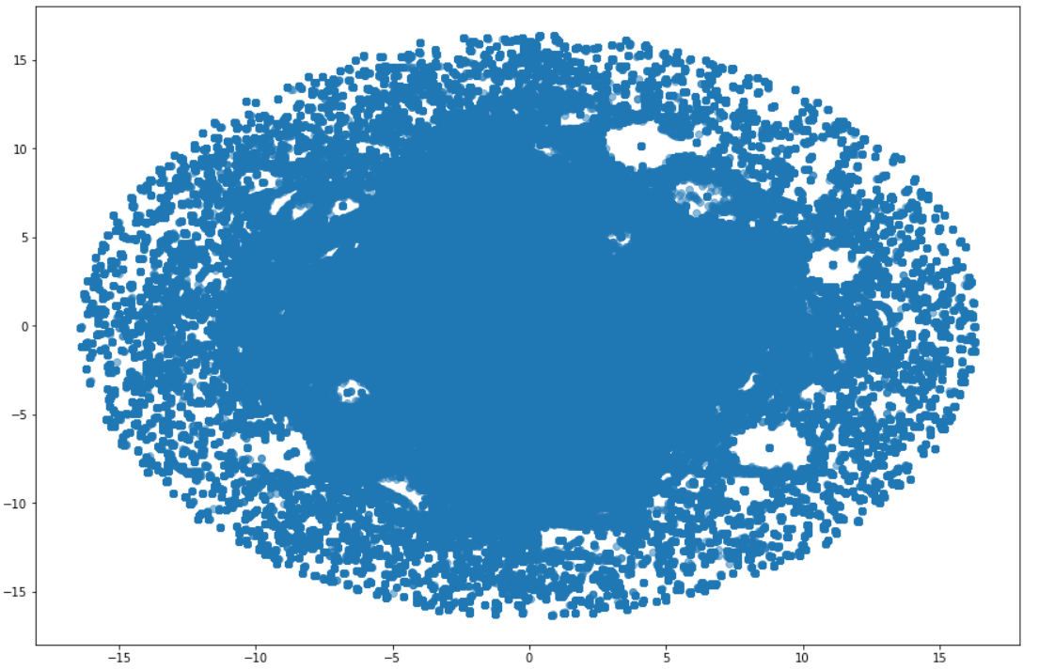
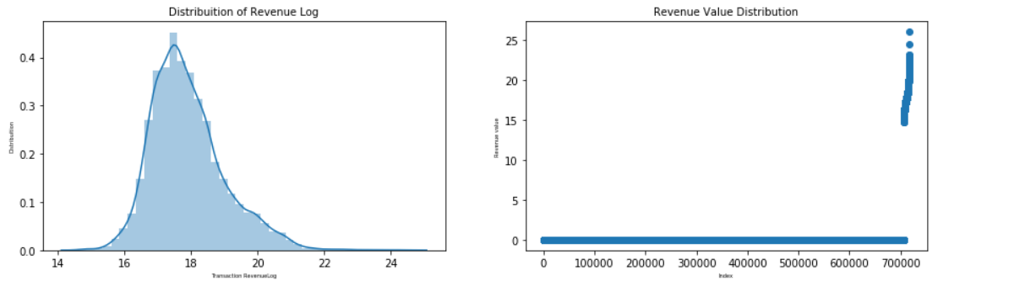
Data Exploration & Feature Engineering
Tsne
Majority of transactions share similar attributes
Overview of total transaction revenue:
For Log of revenue is slightly skewed to right
Only 1.2% of the transactions contribute to total revenue

Slide 7
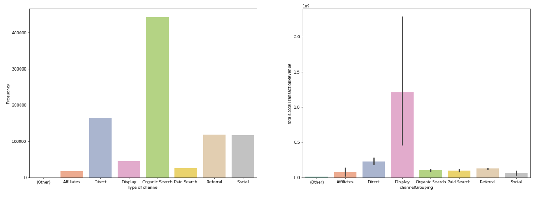
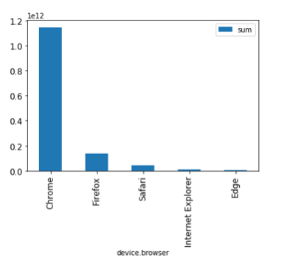
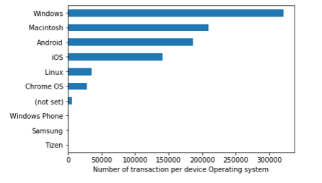
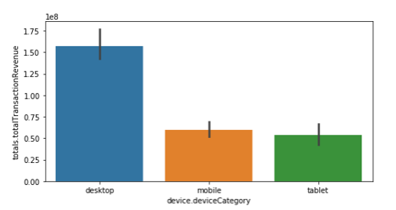
Data Exploration & Feature Engineering
Group channel: Most common channel to access GStore: Organic Search; Direct, Referral and Social Media
Display: the channel with the highest contribution in terms of revenue
Operating System: the first 4 options represent more than 90% of the revenue generated
Device: Desktop is the most used device
Browser: Chrome is the most used

Slide 8
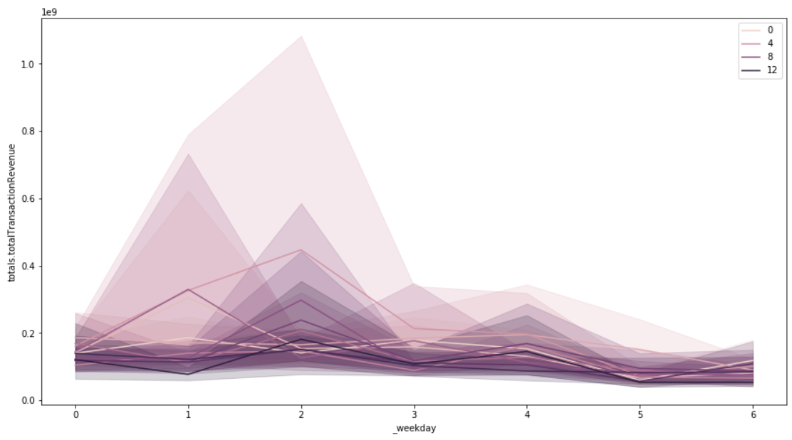
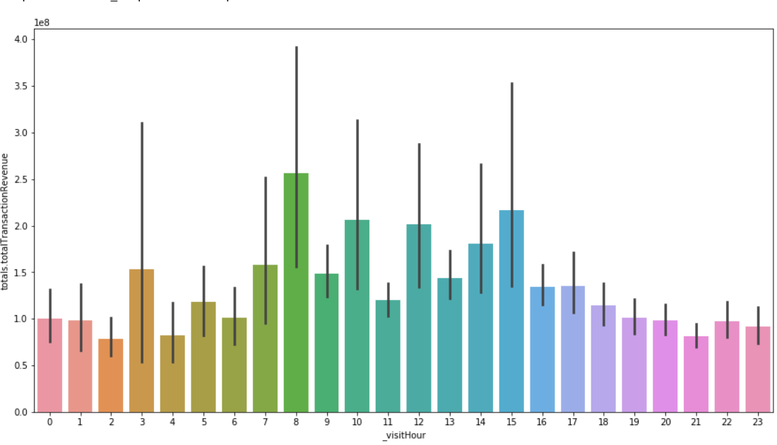
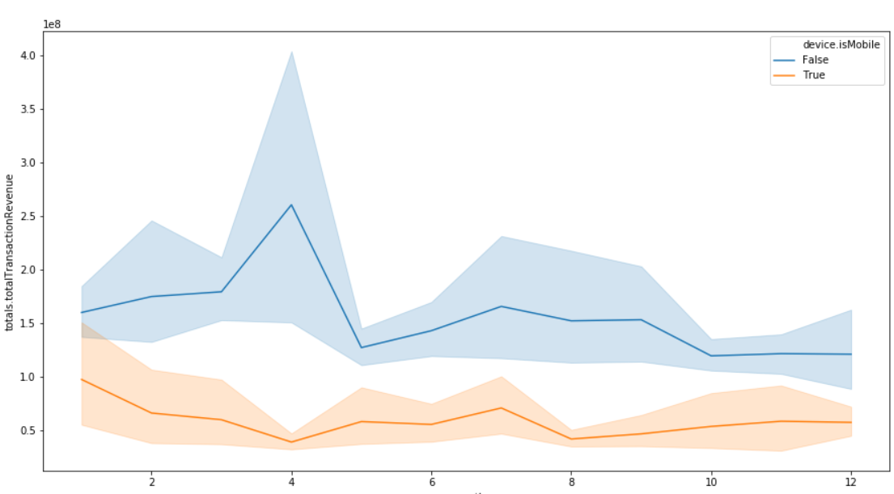
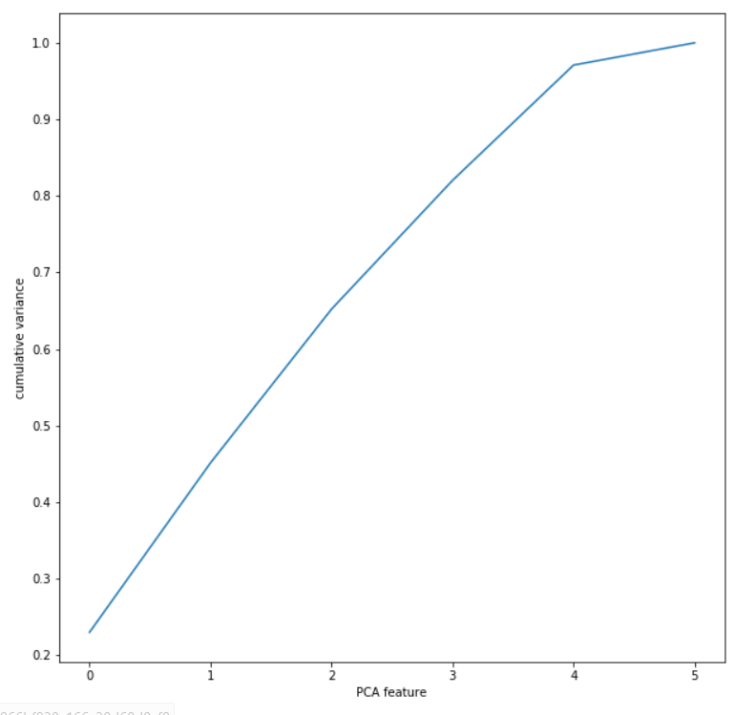
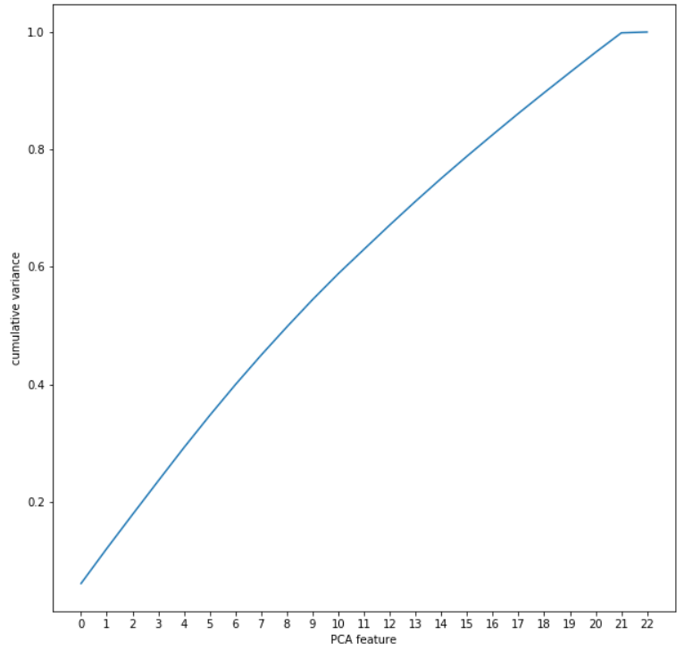
Data Exploration & Feature Engineering
Visitor time analysis:
Tuesday is the pick day
Highest revenue: 3am, 8am, 10am, 12pm, 4pm, 5pm
April is the pick month
Notes:
Decision Tree
Light GBM

Slide 9
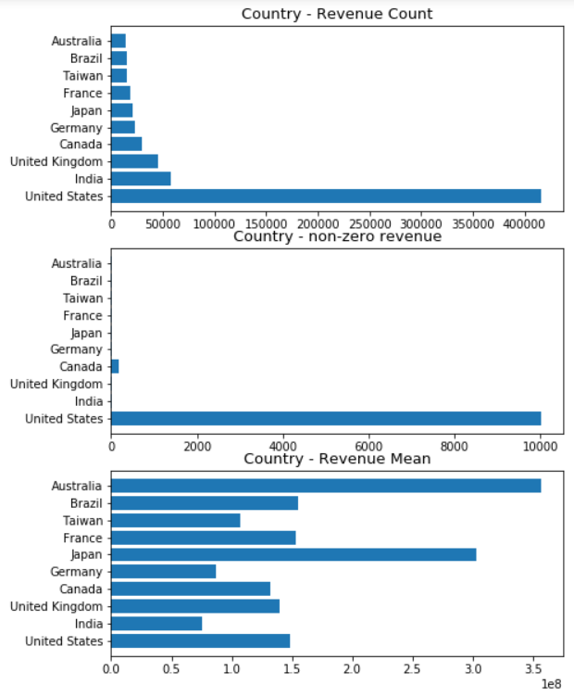
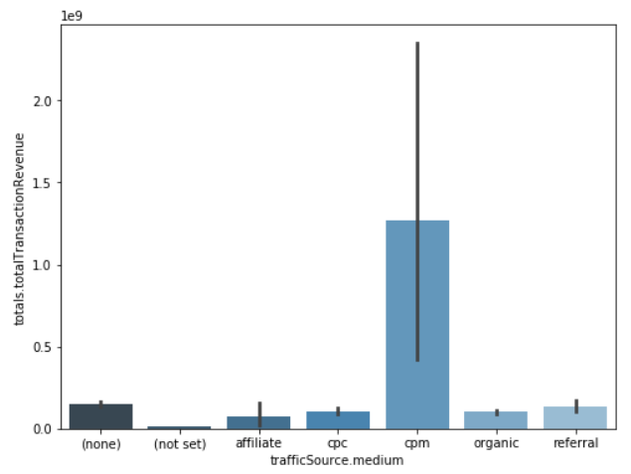
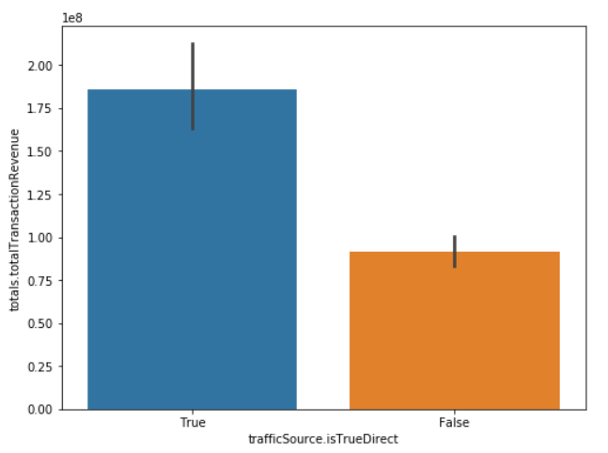
Data Exploration & Feature Engineering
Country & Region:
United States contributed 95% of total revenue
Australia has highest Revenue mean
Create new feature called isUnitedStates, isAustralia
Traffic Source:
CPM contributes main transaction revenues for medium of traffic source
There is difference between True direct and False direct

Slide 10

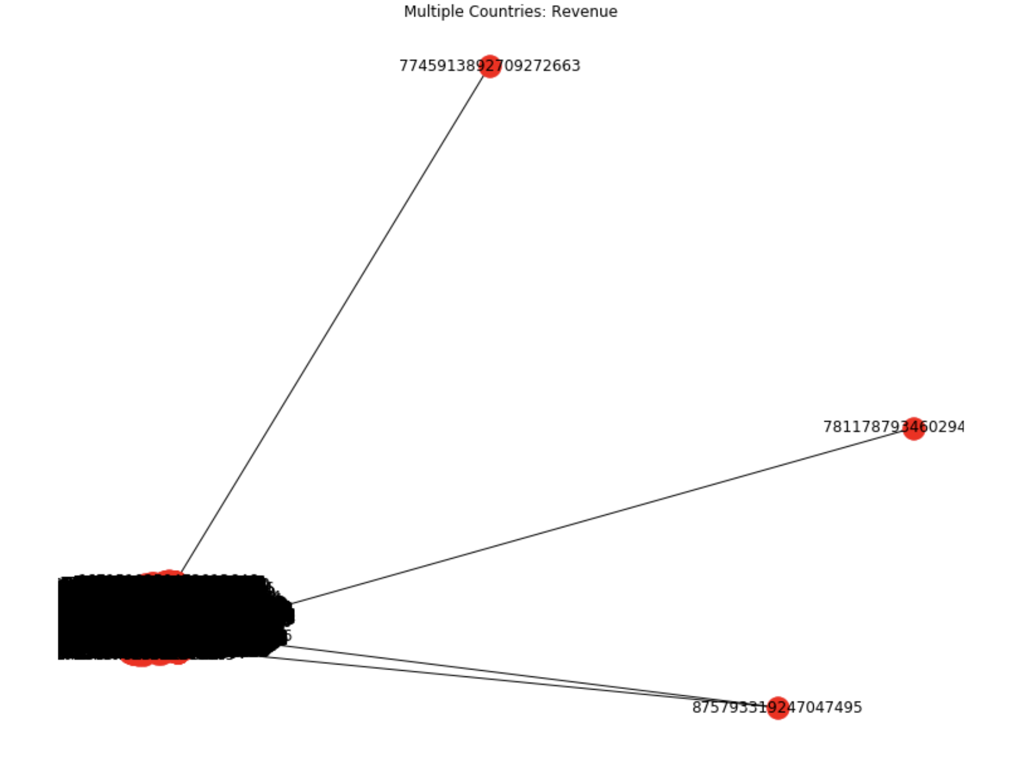
Graph Analysis
Node is User
Edge revenue group for each transaction
- Log revenue rounded to tens place
- Remove zeros
1000 transactions
Revenue
Abnormal User
Subset of Users
- Had transactions from more than one country
Node and Edge similar to Revenue group
- Edge not transformed
(Not Set) country code
Notes:
How people connected and interactions
Took transactions = 0 we removed
Nodes = users
Edges = log revenue, rounded to 10 place
Abnormal user: people that bought in more than one country listed different transactions and connected them into same revenue
10 000 transaction in abnormal users → 3 people = only 2 transactions +

Slide 11
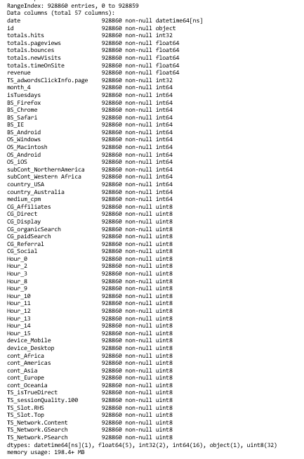
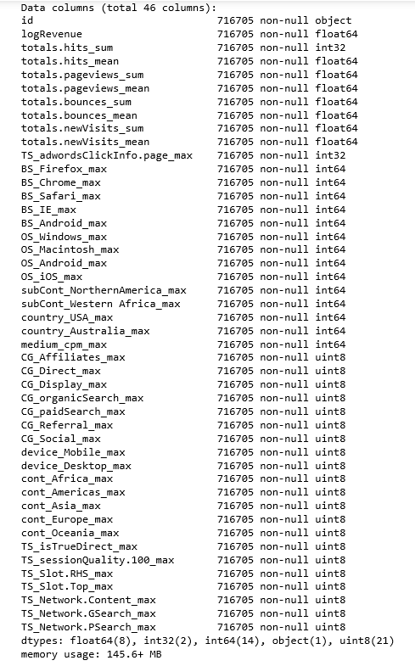
Two different approaches
Transaction level
Customer level

Slide 12

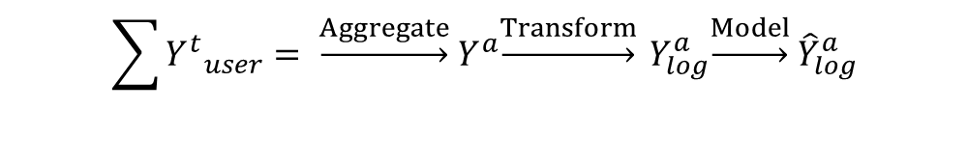
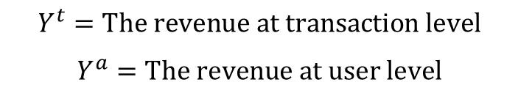
Costumer Level Modeling
Goal
Steps
Aggregate data per user ID
Sum of the original revenue and log of the sum per user
Build Model
Predict the log of the revenue per user
$$Y^{t}=The revenue at transaction level$$
$$Y^{a}=The revenue at user level$$
$${\sum_{ }{{Y^{t}}_{user}}= \underset{→}{Aggregate} Y}^{a}\underset{→}{Transform} Y_{log}^{a}\underset{→}{Model} {\hat{Y}}_{log}^{a}$$
Notes:
Update and steps update

Slide 13

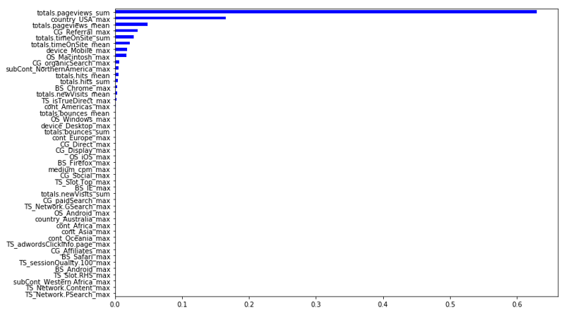
Modeling: Customer level
Models used
Models | RMSE Train | RMSE Test | Cross Validation
Linear Regression | 1.807 | 1.757 | 1.886
Decision Tree | 1.970 | 1.894 | 1.938
Random Forest | 1.970 | 1.894 | 1.970
Light GBM | 1.483 | 1.532 | 1.571
Gradient Boosting | 1.569 | 1.549 | 1.589
XGBoost | 1.558 | 1.553 | 1.588
Notes:
Features importance
Parameters
Tuning model – could have
Overfitting
Cv
Train = 1.558
Test = 1.553
CV = 1.588

Slide 14
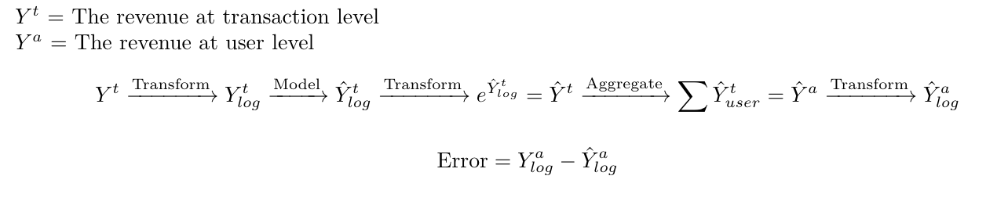
Transaction Level Modeling
Goal
Steps
Log Revenue
Build Model
Exponentiate Predicted values
Aggregate Sum over User ID
Log Predicted
Compare values to Aggregate Log Revenue
Want to predict the transaction level revenue as well as compare our results to the aggregated data

Slide 15
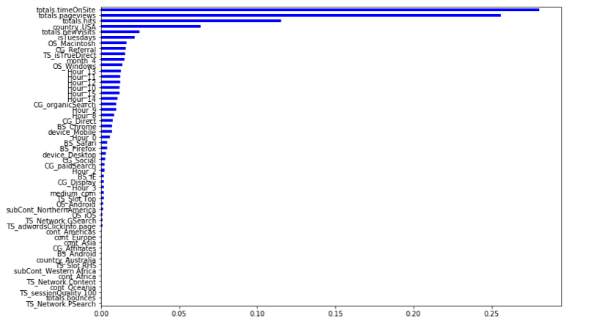
Modeling: Transaction Level
Models used
Models | RMSE Train | RMSE Test | Cross Validation
Linear Regression | 1.780 | 1.724 | 1.781
XGBoost | 1.553 | 1.556 | 1.573
Gradient Boosting | 1.554 | 1.557 | 1.575
Random Forest | 1.587 | 1.575 | 1.596
Light GBM | 1.505 | 1.552 | 1.560
Decision Tree | 1.488 | 2.188 | 2.226
Notes:
CV error = train error >> desired High bias, underfitting
Underfit: increase model complexity , gather more features
CV error > train error High variance
Overfitting: decrease model complexity

Slide 16
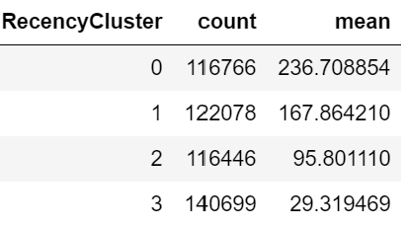
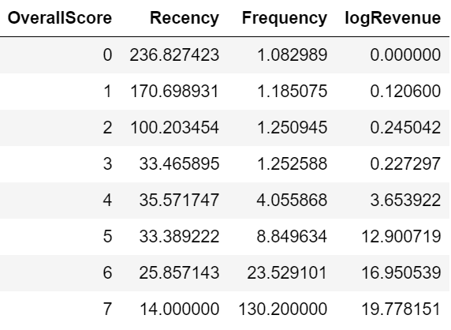
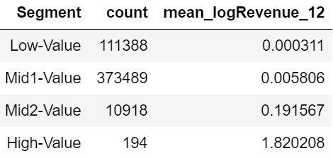
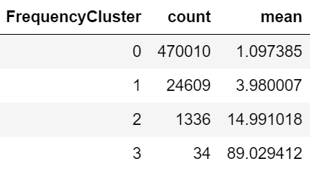
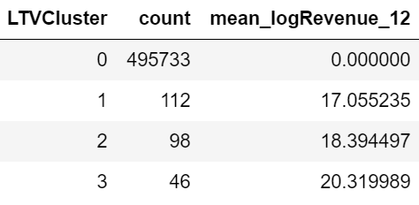
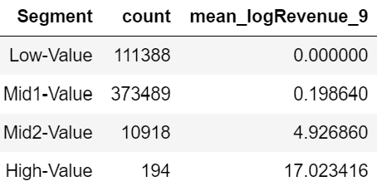
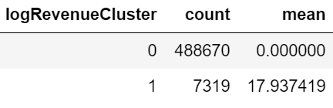
Customer Segmentation & Life Time Value Prediction
Customer Segmentation
LTV Prediction
Jan
Sept
Dec, 2017
logRevenue (last 3 months)
Recency
Frequency
LTV Cluster
logRevenue

Slide 17
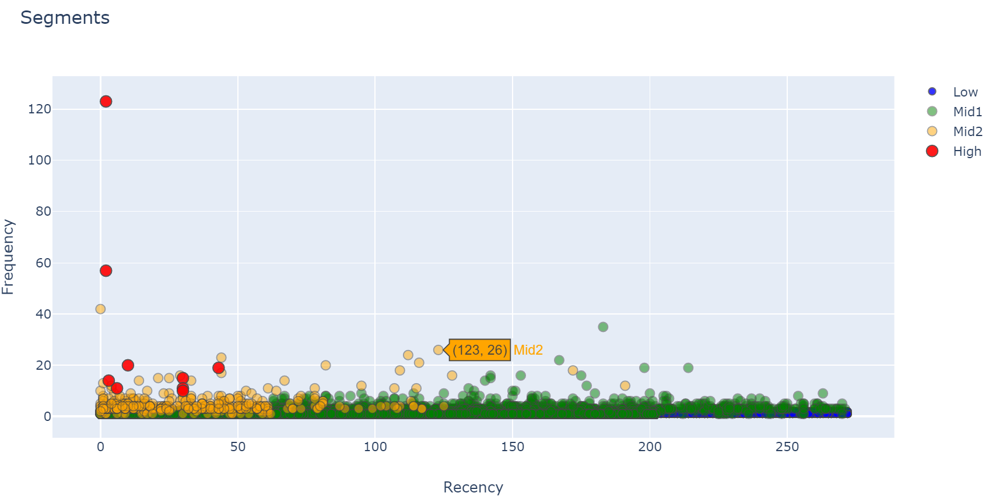
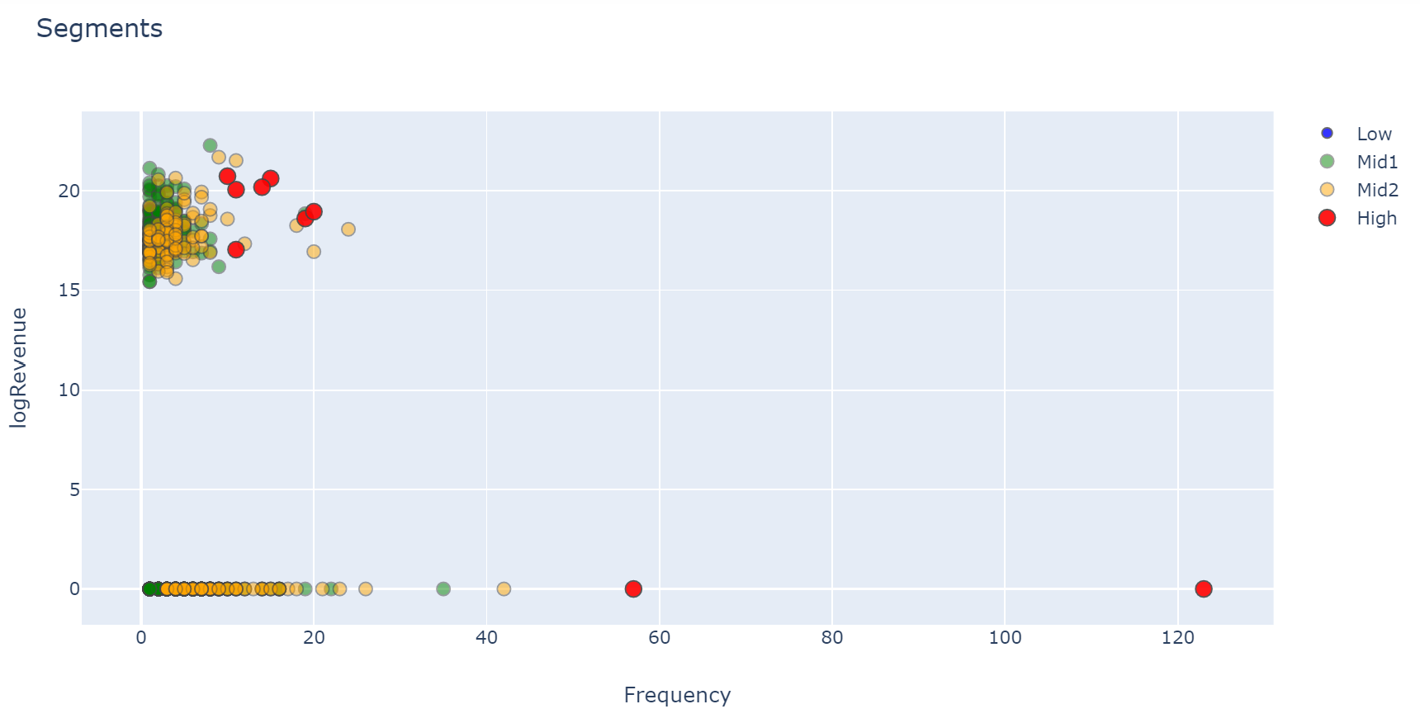
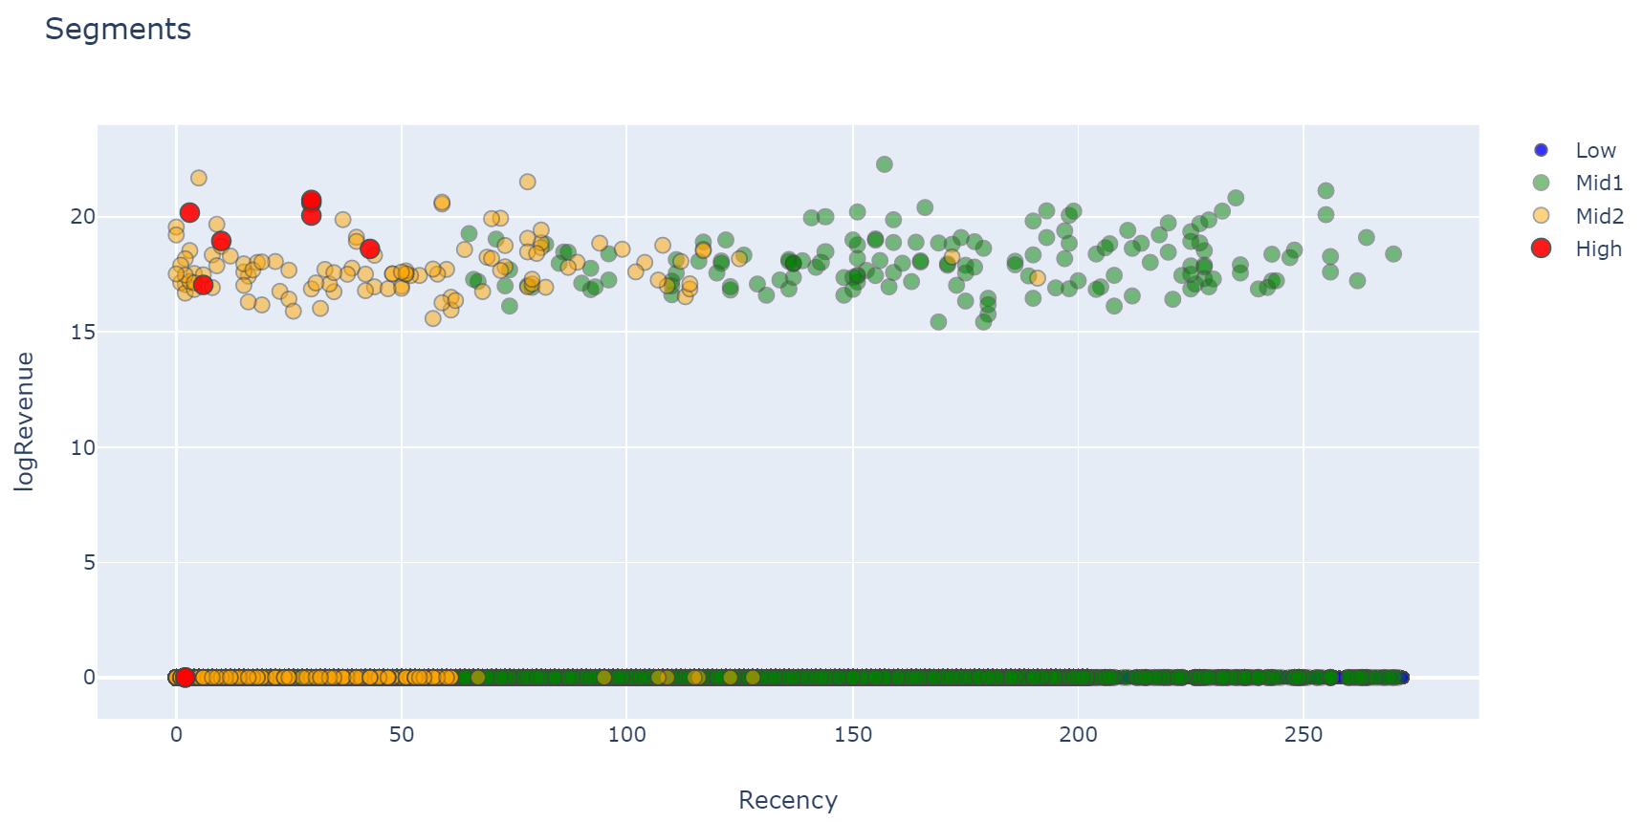
Customer Segmentation
Notes:
Max – min log

Slide 18
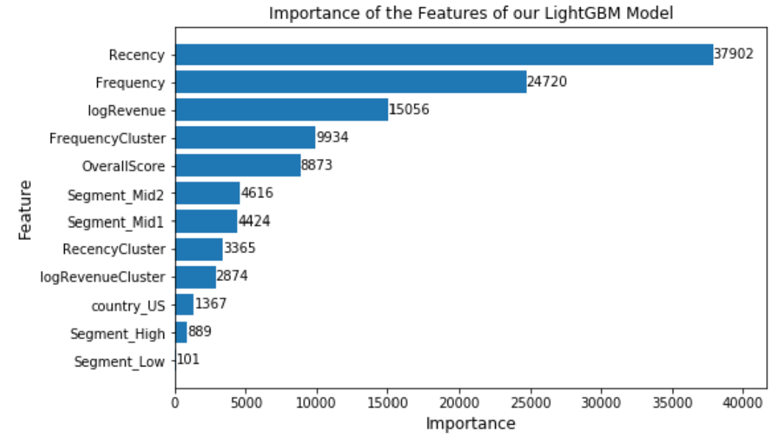
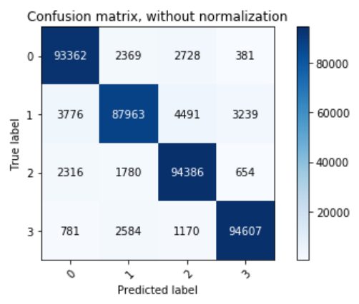
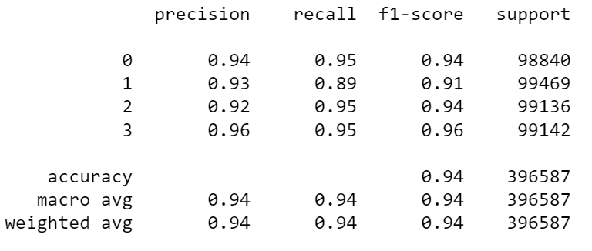
Customer LTV Prediction
Add Features
Continent only
Continent and US
US only
9-month
Features
SMOTE
3-month
LTV Cluster
SMOTE
3-month
LTV Cluster
Predict
Predict
Notes:
Precision how many times you predict 1 and correct (vertical)
Recall how many times you predict 0 and it was 0 (recall)
500 k for each cluster

Slide 19

Lessons Learned & Future Work
Meaningful insights from large datasets sometimes more complicated
Do proper research on models that better suit the specificities of our data
Large data may limit the number of models to use
Keep in mind the business goal throughout the project
Use product level data for more insights
Use several years of data – identify seasonality
Apply more models to Customer segmentation – LTV
Tune models more

Slide 20


Sources
Data: Google Analytics Customer Revenue Prediction – link
Statistics digital buyers – link
Statistics on ecommerce – link & link
Customer lifecycle prediction – link

Slide 21
Q&A

Slide 22

Do the right thing
Analytics
Thank You

